Slide 1
Narrative Visualization
Telling Stories with Data
Yuan-Yao Chang

Slide 2
Introduction
Visualization Designers are “melding the skills of computer science, statistics, artistic design and storytelling. “
Storytelling “require[s] skills like those familiar to movie directors, beyond a technical expert’s knowledge of computer engineering and science. ”
7 Genres:
Magazine style
Annotated chart
Partitioned poster
Flow chart
Comic strip
Slide show
Video

Slide 3
Storytelling with Data Visualization
Jonathan Harris, the creator of We Feel Fine and Whale Hunt, said
“I think people have begun to forget how powerful human stories are, exchanging their sense of empathy for a fetishistic fascination with data, networks, patterns, and total information... Really, the data is just part of the story. The human stuff is the main stuff, and the data should enrich it.”
Story: Who / What / Where / When / Why / How.
What makes data visualization different from other types of visual storytelling?
Wojtkowski and Wojtkowski said that is the complexity of the content that needs to be communicated.
“Visual storytelling, in turn, might be of critical importance in providing intuitive and fast exploration of very large data resources,”

Slide 4
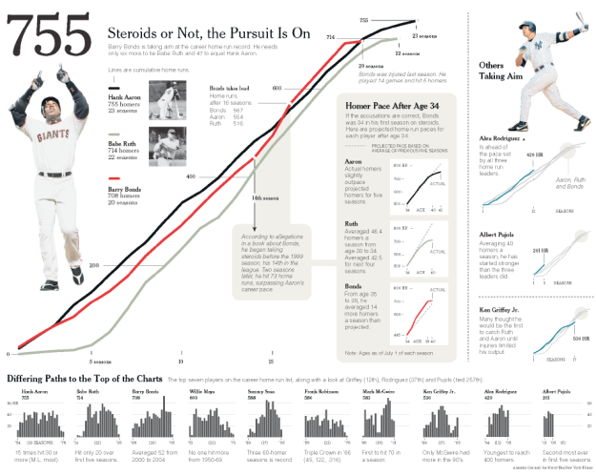
Case 1
Steroids or No, the Pursuit is On New York Times.
Upper Left Section
Line chart - three hitter comparison
Shaded annotation
coincide with steroid use to take lead
Second annotation
Age > 34 comparison

Slide 5
Case 1
Steroids or No, the Pursuit is On New York Times.
Right Section - Current Player
Second largest image
Bold Font - Others Taking Aim
Bottom Section
Devoid Color and smaller plots
Minimum visual priority
Completes the story

Slide 6
Case 1
Steroids or No, the Pursuit is On New York Times.
Final
Sub-stories with charts, pictures and text
Sections link by color, shape and text
Black, Green and Red Line
Matching on content
Same order lines
Right section shadow of origin lines
Visual Highlighting(size, color, boldness)

Slide 7
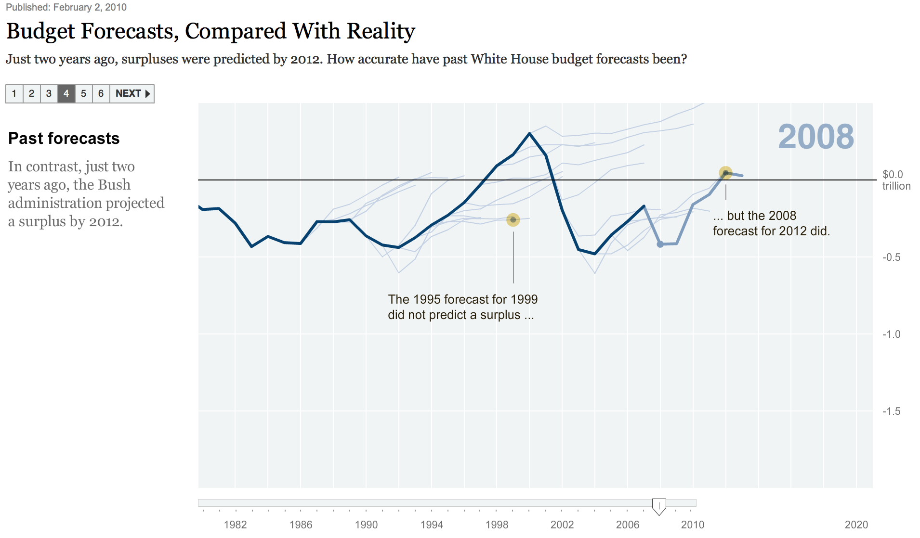
Case 2
Budget Forecasts, Compared With Reality New York Times.
Large Headline
Two panels
Left: bold headline, short text
Right: Line Chart (1980-2020)
Estimate line separated from actual data
Progress Bar

Slide 8
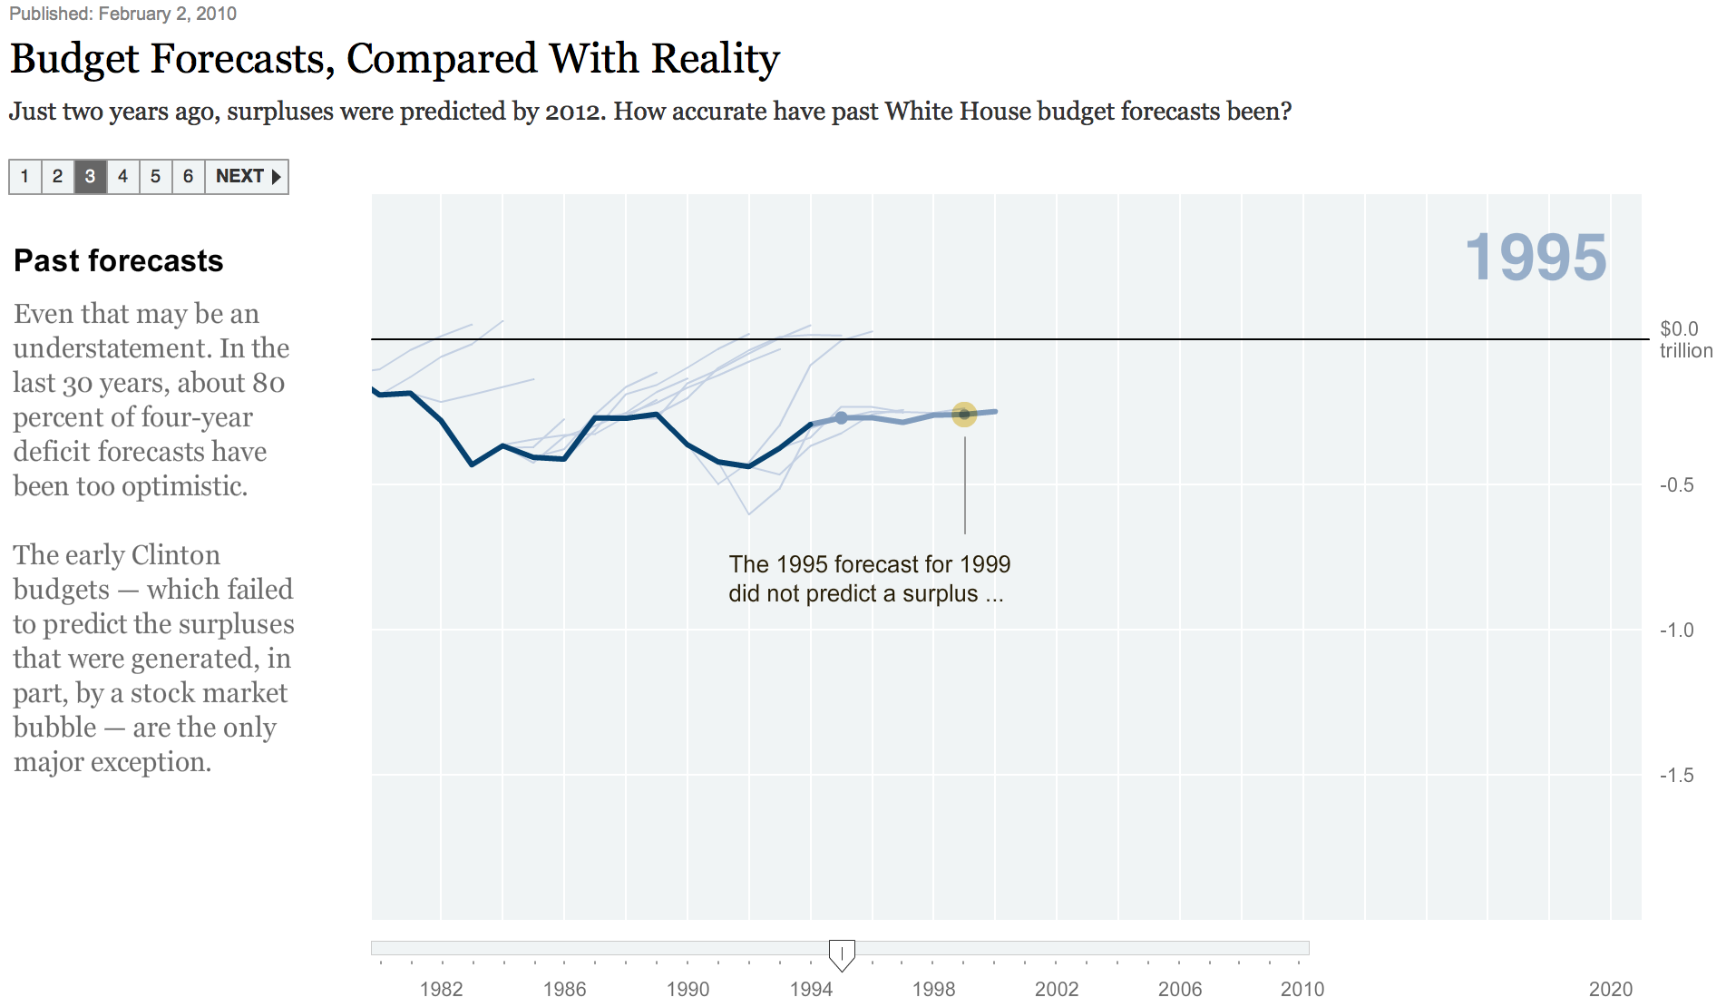
Case 2
Budget Forecasts, Compared With Reality New York Times.
Consistent Visual Platform
Update left text
Anitmated transition right panel
Multi-messaging
Details-On-Demand
Time Slider - select years

Slide 9

Case 2
Budget Forecasts, Compared With Reality New York Times.
Slide-show with
Pace and year determined by user
Mousing-over charts to explore
Interactive slideshow
Single-frame interactivity
Tacit tutorial
“Martini Glass Structure” – limited at first, then opening up for free exploring

Slide 10
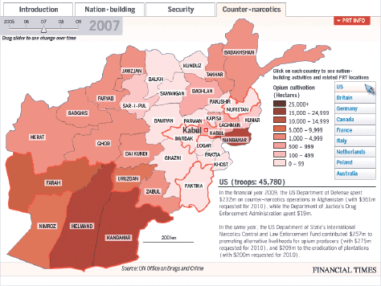
Case 3
Afghanistan: Behind the Front Line Financial Times.
PRT - Provincial Reconstruction Teams
Purpose :
To establish indicators of success
Four Tabs
Identical Map
Different Color (red, blue, green)
Semantically Consistent
Nation-Building, Security, Counter-Narcotics (Timeline slider)

Slide 11
Case 3
Afghanistan: Behind the Front Line Financial Times.
Each Tab with
NATO countries on the right
Short message and mouse indicator
Troops deployed borders red line
Paragraph of text
Details-on-Demand - PRT info
Consistent visual platform
Marker of interactivity

Slide 12
Case 3
Afghanistan: Behind the Front Line Financial Times.
Improvements:
Guide to the viewers
Questions
Why does some regions cost more?
- Annotations
Which Countries provide the best aid?
- Comparisons
What projects exist in a particular region?
- Region Selection
Too much info in a paragraph
Synthesis or Summary

Slide 13
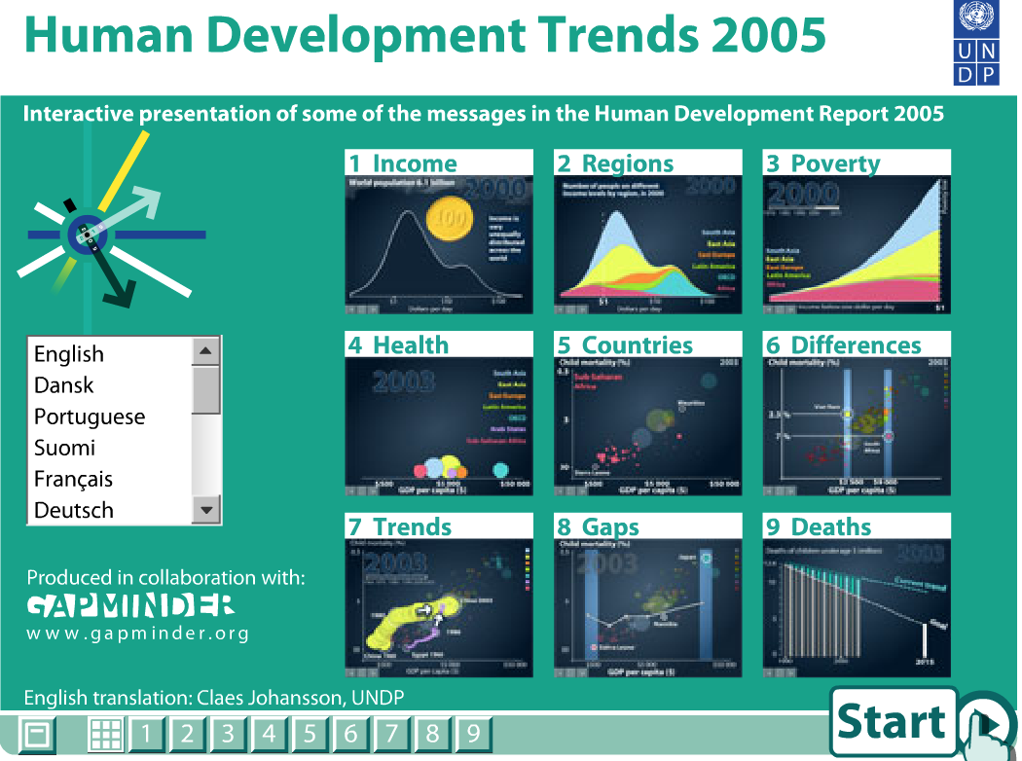
Case 4
Human Development Trends Gapminder.
Interactive Slideshow
Checklist Structure
Grid of Screenshots
Progress Bar
Language selection
Start Button -> forward, back
2nd Progress Bar

Slide 14
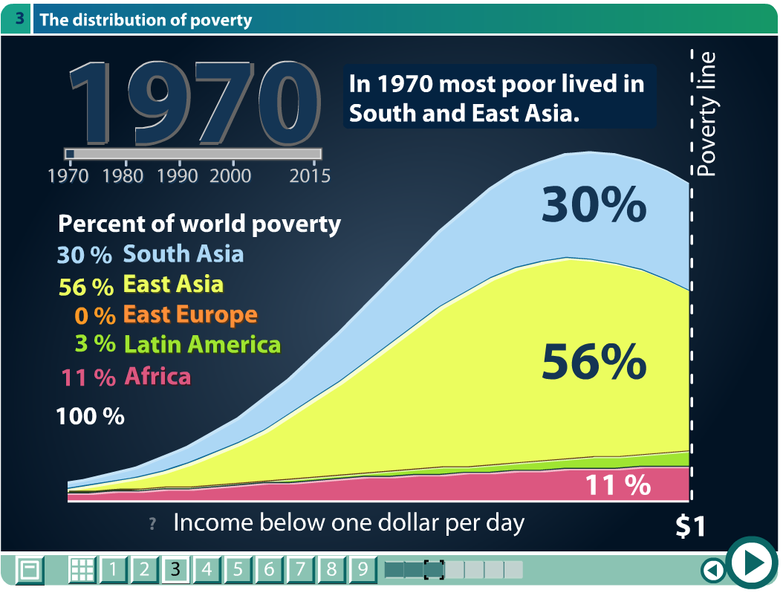
Case 4
Human Development Trends Gapminder.
Histograms
Scatter plots
Bar Charts
Animated Transition between plots
Annotation
Highlighting
Single-frame interactivity
Stepwise
Details-On-Demand

Slide 15
Case 4
Human Development Trends Gapminder.
Annotation
Allow dense info to read quickly
Semantically consistent in color encode
Martini Glass Structure after narrative
Timeline Slider

Slide 16
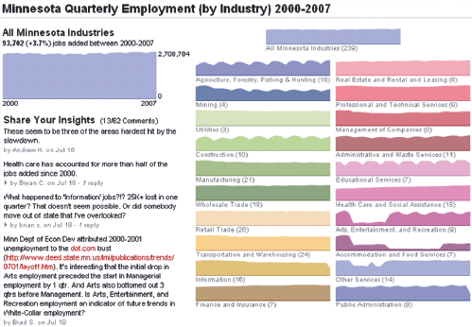
Case 5
The Minnesota Employment Explorer
MPR - Minnesota Public Radio 2000 - 2007
Details-On-Demands - hover cursor
Animated Transition - double click
Social Interaction Comments
linked with visualization
Fail the Goal of interactive comments
None Minnesota citizen
Post by producers

Slide 17
Case 5
The Minnesota Employment Explorer
Improvements:
Place at the below, been overlooked
Lack of Tacit tutorial
Graphics disconnected with narrative
Only 2000-2007 while
2008 is the economic woes

Slide 18
Design Space Dimensions
Genres
Magazine style, Annotated chart, Partitioned poster, Flow chart, Comic strip, Slide show, Video / Film / Animate.
Visual Narrative Tactics
Visual structuring: overall structure
Highlighting: color, motion, framing, size…etc.
Transition guidance: moving between visuals without disorienting viewer
Narrative Structure
Ordering: linear, random access, user-directed
Interactivity: how user manipulate visualizations
Messaging: visuals communicates observations and commentary to user

Slide 19
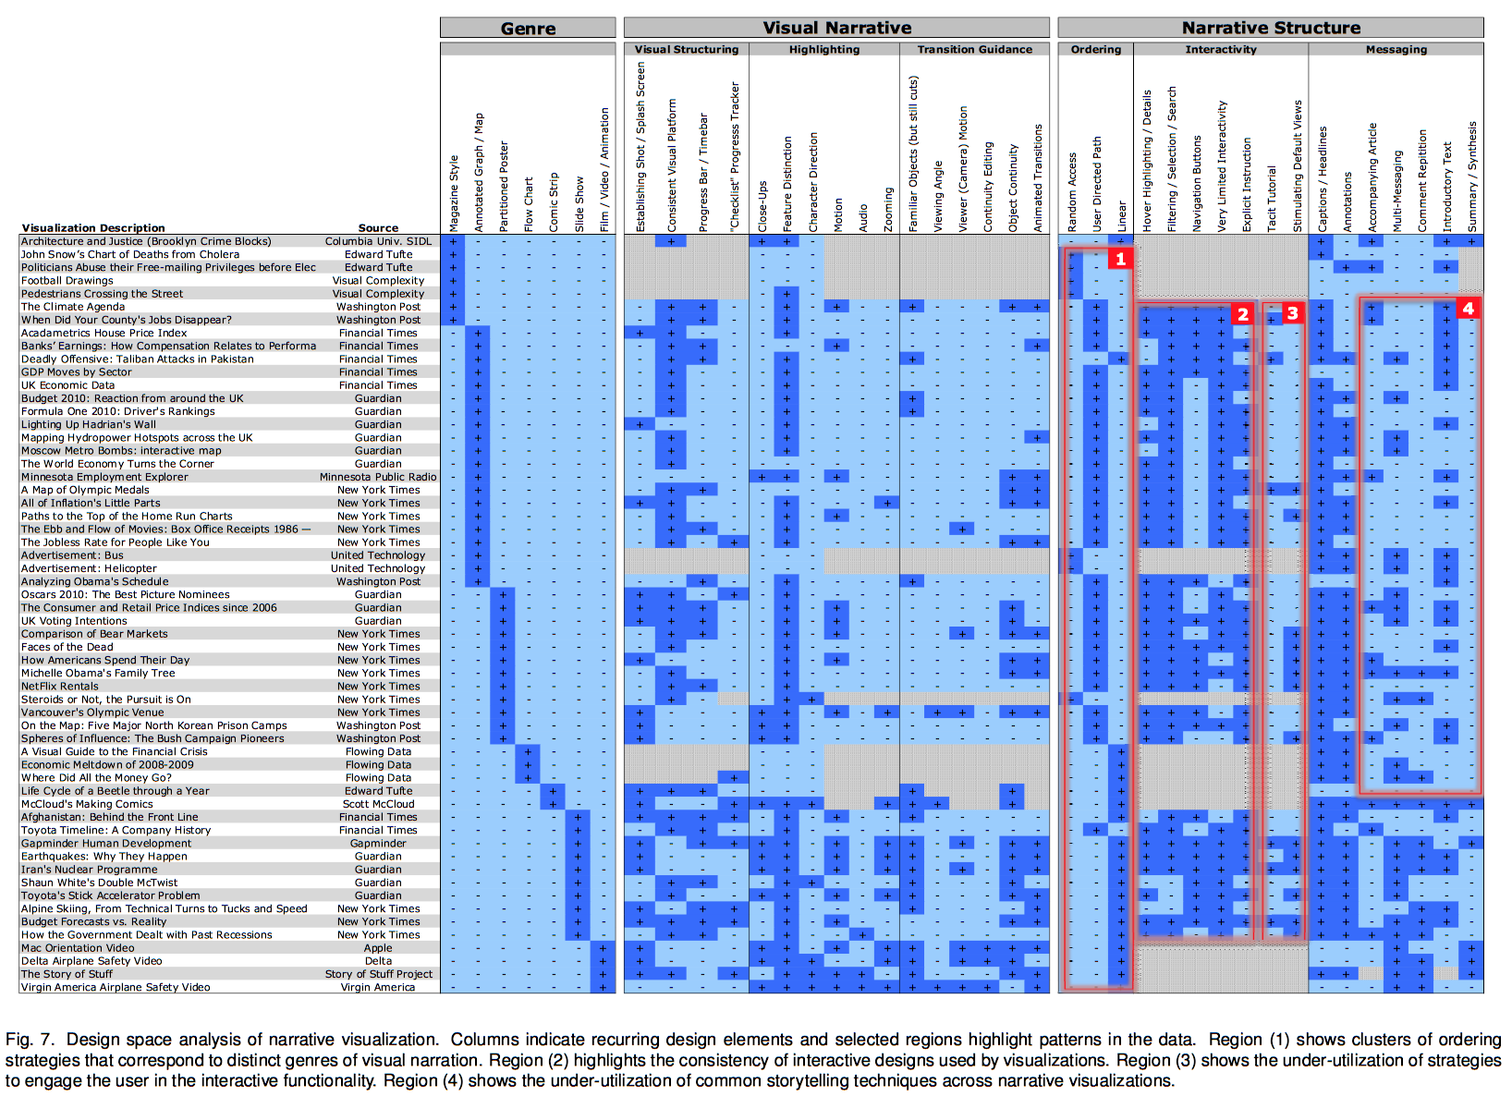

Slide 20
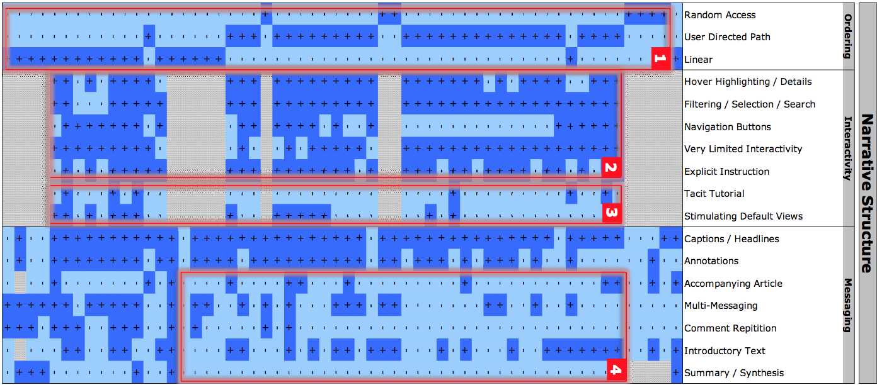
Design Space Observations
(1) How visualization guide the viewer
(2) Interaction design choices
(3) Initial guidance
(4) Common narrative messaging

Slide 21
Author-Driven
Reader-Driven
Linear
Messaging
No interactivity
Ex. Film
No prescribed ordering
No messaging
High degree of interactivity
Ex. tools like Tableau

Slide 22

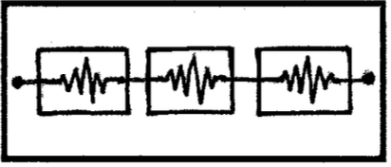
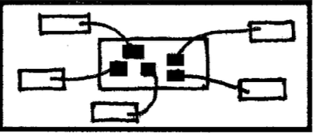
MIX
Martini Glass Structure
Author-driven approach
Limited first. Open up later
Interactive Structure
Mix of author, reader-driven approach
Drill-Down Story
More on reader-driven approach
Details-on-demand

Slide 23
Discussion
The balance between author-driven elements
Data stories appear to be most effective when they have constrained interaction at various checkpoints within a narrative, allowing the user to explore the data.

Slide 24
Reference
Narrative Visualization: Telling Stories with Data By Jeffrey Heer and Edward Segel

